Slide 1
Modulisation decomposition

Slide 2
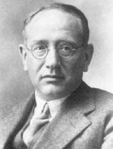
Polya’s Problem Solving Strategy
First principle: Understand the problem
Second Principle: Devise a plan
Third principle: Carry out the plan
Fourth principle: Look Back

Slide 3
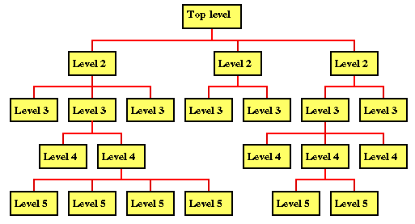
Top down
Hierarchical structure on the design of the program.
Define the solution at the highest level of functionality
Split it down further
… and further into small routines
These can be easily documented and coded.

Slide 4
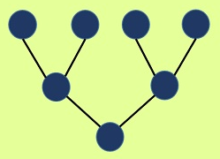
Bottom up
Bottom-up developing is a type of software development process that is based on using incoming data from the environment to form a perception.
For example if thinking about the human body sensory input is given through the eyes, which is then converted by the brain into a bigger picture that we see

Slide 5
Today we will look at
Modulisation
Decomposition
Pattern Recognition

Slide 6
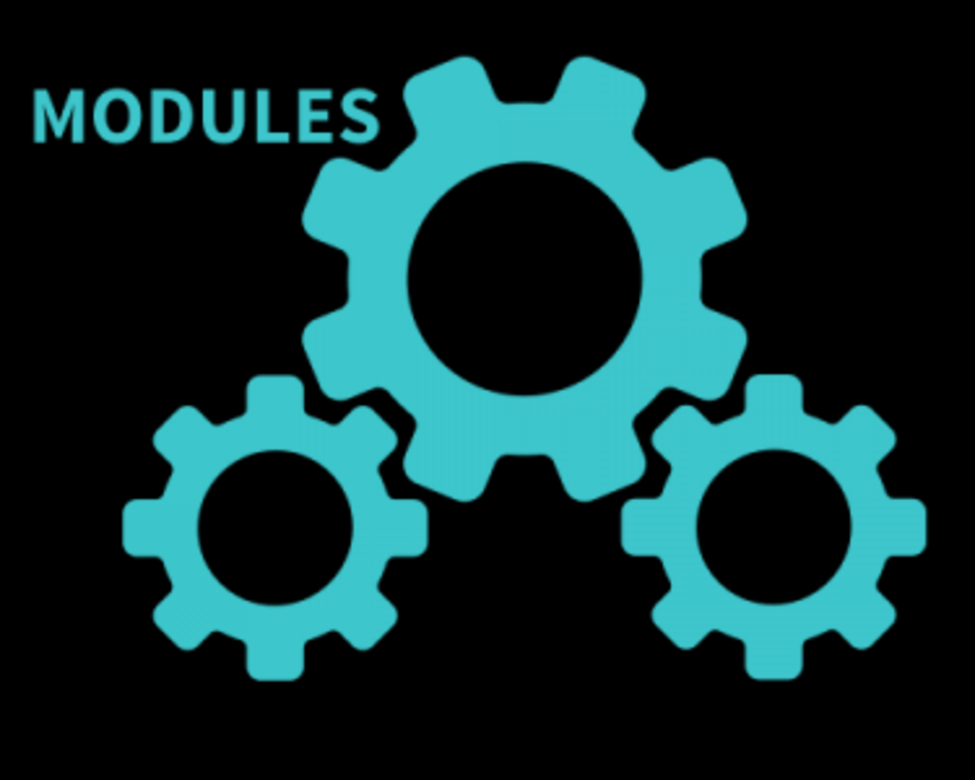
Modualisation
Modular programming is the process of subdividing a computer program into separate sub-programs
E.g. Object Orientated Programming / libraries of code / common code e.g. dlls
A module is a separate software component.
Modules can often be used in a variety of applications and functions with other components of the system.
Can you think of any common modules?

Slide 7
(You don’t need to know this) Windows dlls
Kernel.dll – memory management, IO, create processes
GDI32.dll – graphics device interface. Primitive drawing functions to video or printers.
WS2_32.DLL – Winsock, provides TCP/IP networking functions
USER32.DLL – creates windows, buttons, desktop, menus (the GUI)

Slide 8
Decomposition
Decomposition is one of the four cornerstones of Computer Science.
It involves breaking down a complex problem or system into smaller parts that are more manageable and easier to understand.
The smaller parts can then be examined and solved, or designed individually.

Slide 9
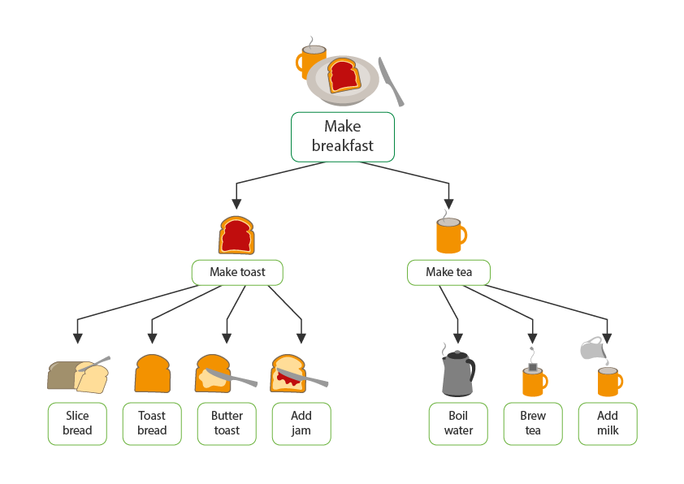

Slide 10
NEW WEBSITE!
GUI / UX / Front end
Python / Database
Photoshop
HTML / css
js
Python
Tables / queries

Slide 11

For example to solve a crime, a police officer would need to know the answer to a series of smaller problems:
what crime was committed
when the crime was committed
where the crime was committed
what evidence there is
if there were any witnesses
if there have recently been any similar crimes
The complex problem of the committed crime has now been broken down into simpler problems that can be examined individually, in detail.

Slide 12
Pattern Recognition
While we hear this term a lot in the IT world, it originally comes from cognitive neuroscience and psychology.
1, 2, 3 ….
2, 4, 6 …

Slide 13
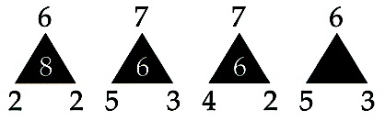
Notes:
6-2 * 2 = 8
7-5 * 3 = 6
7-4 * 2 = 6
6-5 * 3 = 3

Slide 14
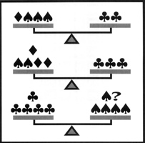
Notes:
ANSWER:
Four diamonds
SOLUTION:
First add up the number of clubs in the first two scales (5). Then count how many clubs are in the bottom scale (5). The do the same with the spades, which gets you 5 and 5. There are 4 diamonds in the top two balanced scales. Therefore, it must take 4 diamonds to balance the third scale since all the other measurements are the same.

Slide 15
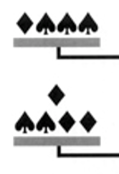
? = + 4 diamonds
=
Notes:
ANSWER:
Four diamonds
SOLUTION:
First add up the number of clubs in the first two scales (5). Then count how many clubs are in the bottom scale (5). The do the same with the spades, which gets you 5 and 5. There are 4 diamonds in the top two balanced scales. Therefore, it must take 4 diamonds to balance the third scale since all the other measurements are the same.

Slide 16
Using patterns
In the world of software programming, it isn’t unusual to face the same issues over and over.
It is also not uncommon that these issues present themselves once the code is already out there.
Investigate already established solutions to common coding problems
Transferable skills and information to new and unexpected problems.

Slide 17
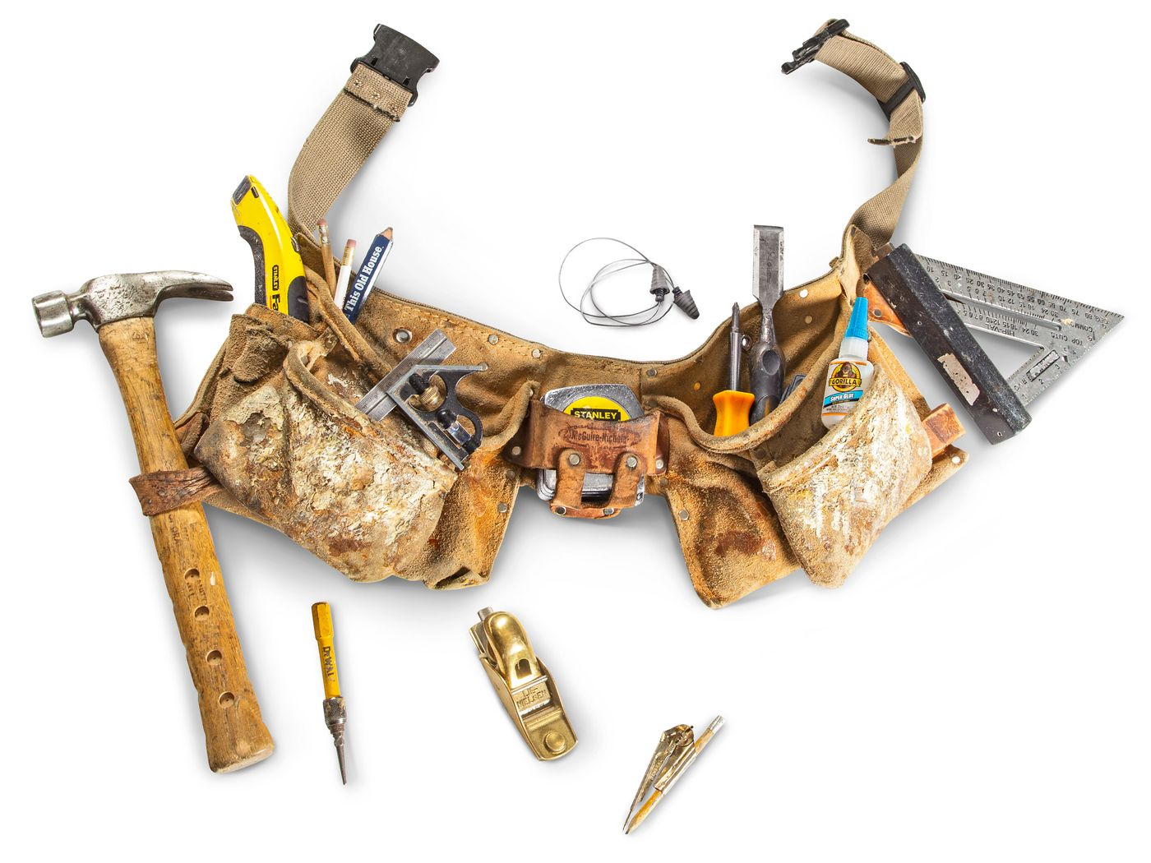
Pattern example
Knowing how to drive a bike, e.g. changing lanes (check behind you, signal, change lane)
Driving a car – similar pattern of behaviour
Can transfer to vans, trucks etc
Can be transferred to a new domain, e.g. self driving algorithms
Have you seen a problem like this before?
Can you apply any data structures / algorithms / design patterns?

Slide 18
Worksheet

